Slide 1
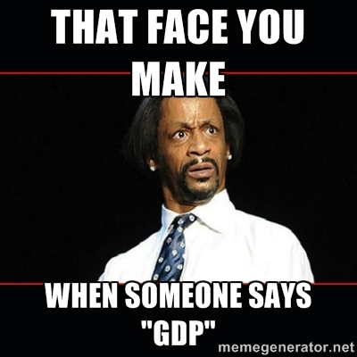
Chapter 6: Introduction to Macroeconomics and GDP
Wayne Geerling
University of Texas

Slide 2
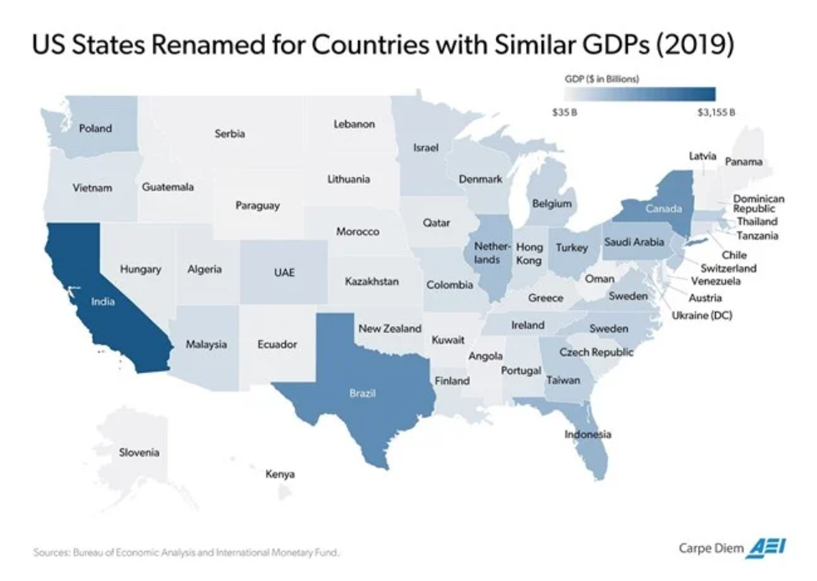

Slide 3
Big Questions
1. How is macroeconomics different from microeconomics?
2. How is GDP computed?
3. What does GDP tell us about the economy?
4. What are some shortcomings of GDP data?

Slide 4
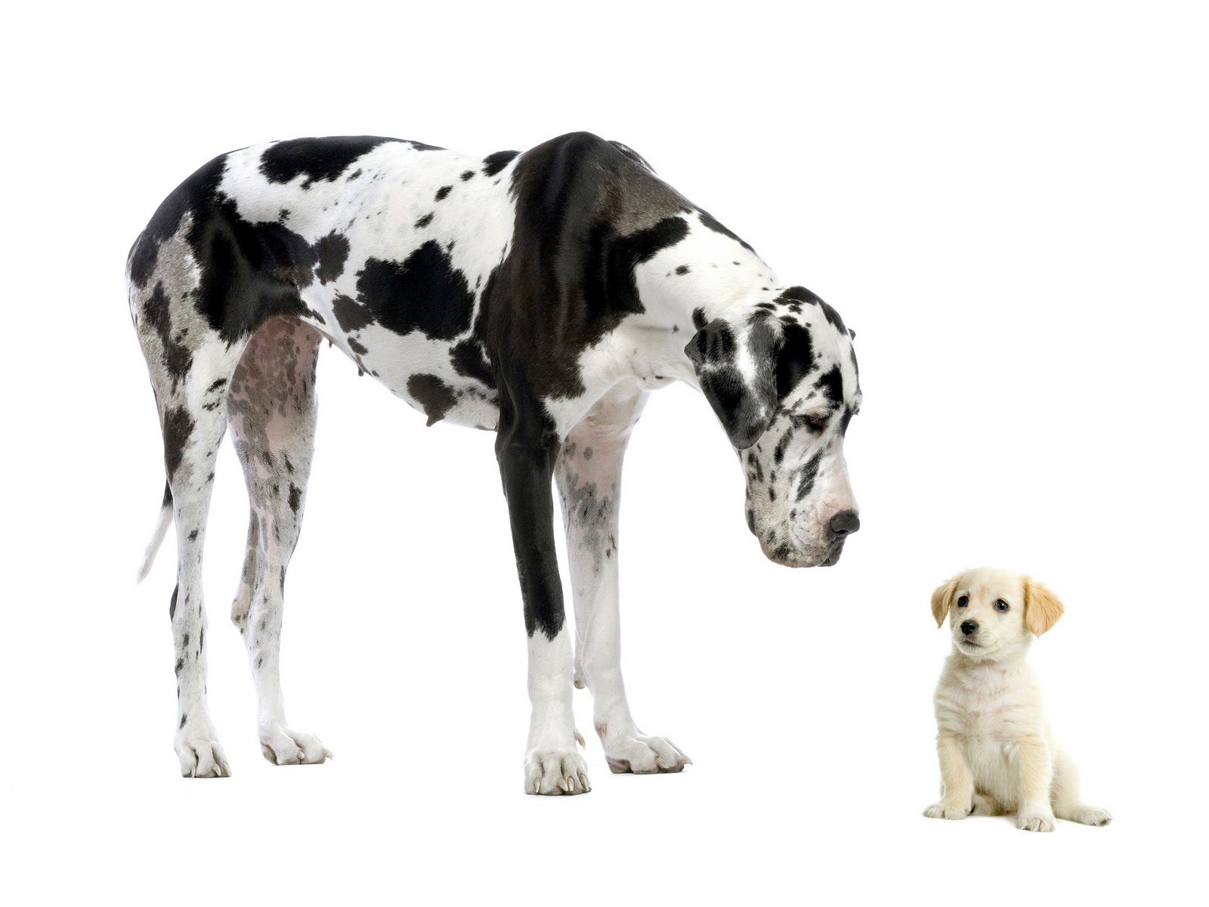
Macroeconomics vs Microeconomics
Macroeconomics: study of the economy as a whole. For example: economic growth, unemployment, inflation, etc.

Slide 5
Microeconomics: study of decision making by individuals & firms along with how the government influences those decisions.

Slide 6

GDP Measures Total Production
Gross Domestic Product: The market value of all final goods and services produced within a country during a specific period of time
It is the sum of output from all (legal) economic activity.

Slide 7




The Circular Flow
goods and services
goods and services
taxes
Firms
Government
Households
wages, interest & transfers
taxes
wages, interest & dividends
Arrows represent flow of money

Slide 8
1. What GDP Measures
Gross Domestic Product (GDP)
The market value of all final goods & services produced in a country during a specific period of time
Important notes:
Includes only final goods & services
Includes only current production
Does not include transfer payments

Slide 9
GDP Counts the Market Value
Suppose the country of Gondor produces the following: 10 oranges, 15 cloaks, and 6 swords
Would it make sense to add them up to get output?
Need market value: Q x P
Goods produced | Quantity | × | Unit Price | = | Market value
Corn | 12 billion bushels | × | $5 | = | $60 billion
Cars | 8 million vehicles | × | $30,000 | = | $240 billion
 |  |  |  |  | $300 billion

Slide 10
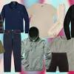
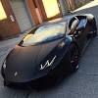

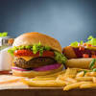




GDP Includes Goods & Services
Goods
tangibles
Services
intangibles

Slide 11
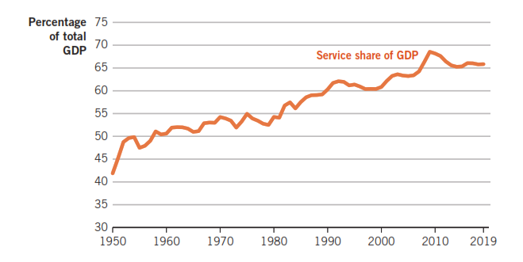
GDP Includes Goods & Services
Shift from manufacturing to services.

Slide 12
Intermediate Steps in Cell Phone Production
Steps | Value added during step | Prices of completed steps
1. Outer case and keyboard | $5 | $5
2. Internal hardware | $10 | $15
3. Install operating system | $15 | $30
4. Connect to network | $49 | $79
5. Retail sale | $120 | $199
Sum total | $199 | $328

Slide 13
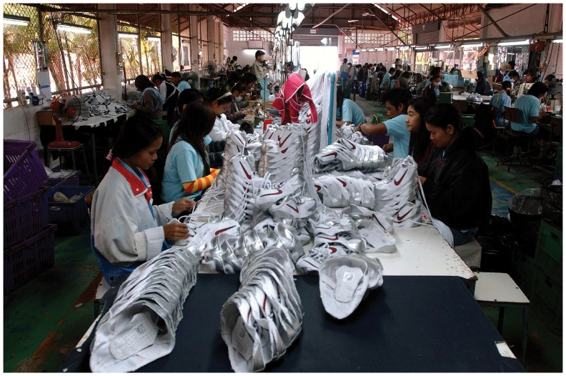
GDP Includes Goods Produced within a Nation
Gross National Product (GNP): Output produced by workers & resources owned by residents of the nation.
Nike shoes made in Thailand would count toward U.S.’s GNP but toward Thailand’s GDP.

Slide 14
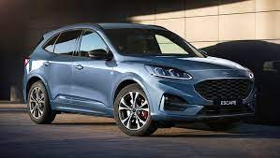
GDP Only Looks at a Particular Period
A new car is produced and sold in 2018.
Two years later, the owner decides to sell it.

Slide 15
What’s included in U.S. GDP?

Slide 16
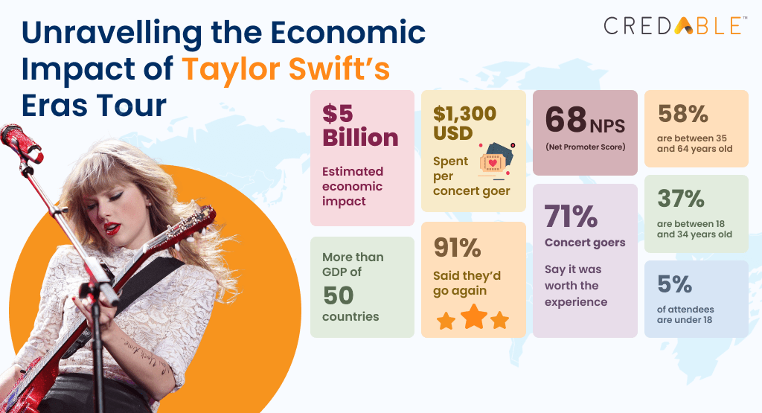

Slide 17

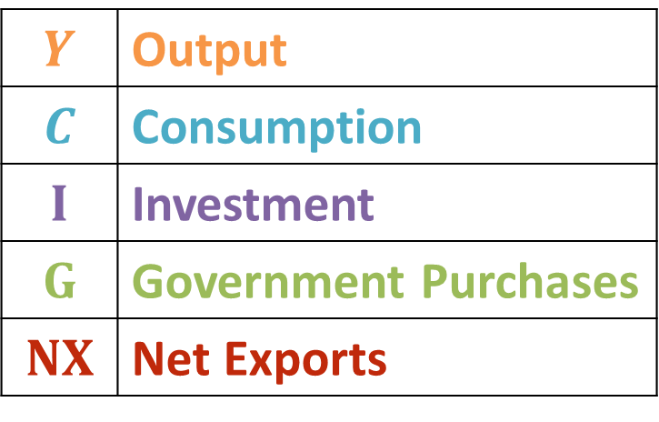
Four Components of GDP
The Bureau of Economic Analysis (BEA) is the U.S. government agency that tallies GDP data, a task called national income accounting.
 | Output
 | Consumption
 | Investment
 | Government Purchases
 | Net Exports

Slide 18
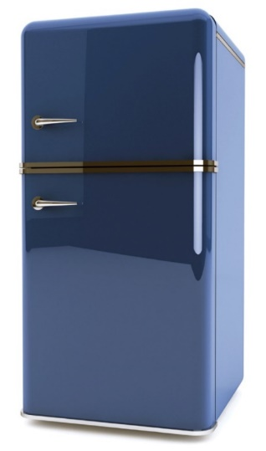
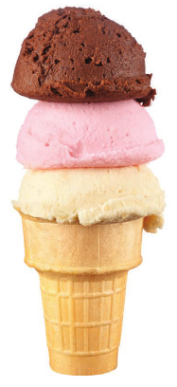

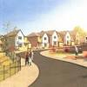
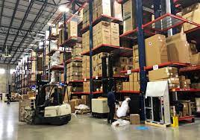


Four Components of GDP
3 main types of investment
Durable and non-durable goods

Slide 19
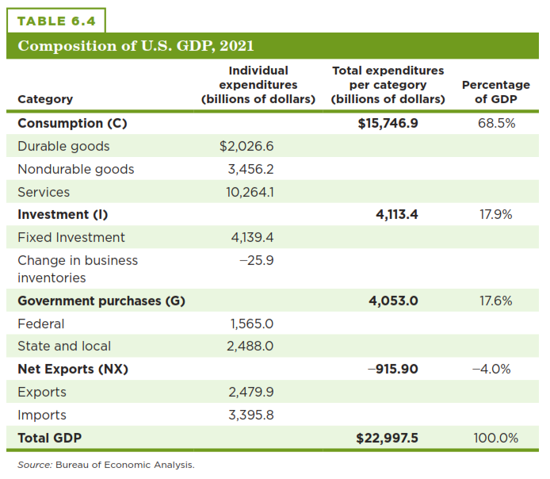
U.S. GDP & Its Components

Slide 20
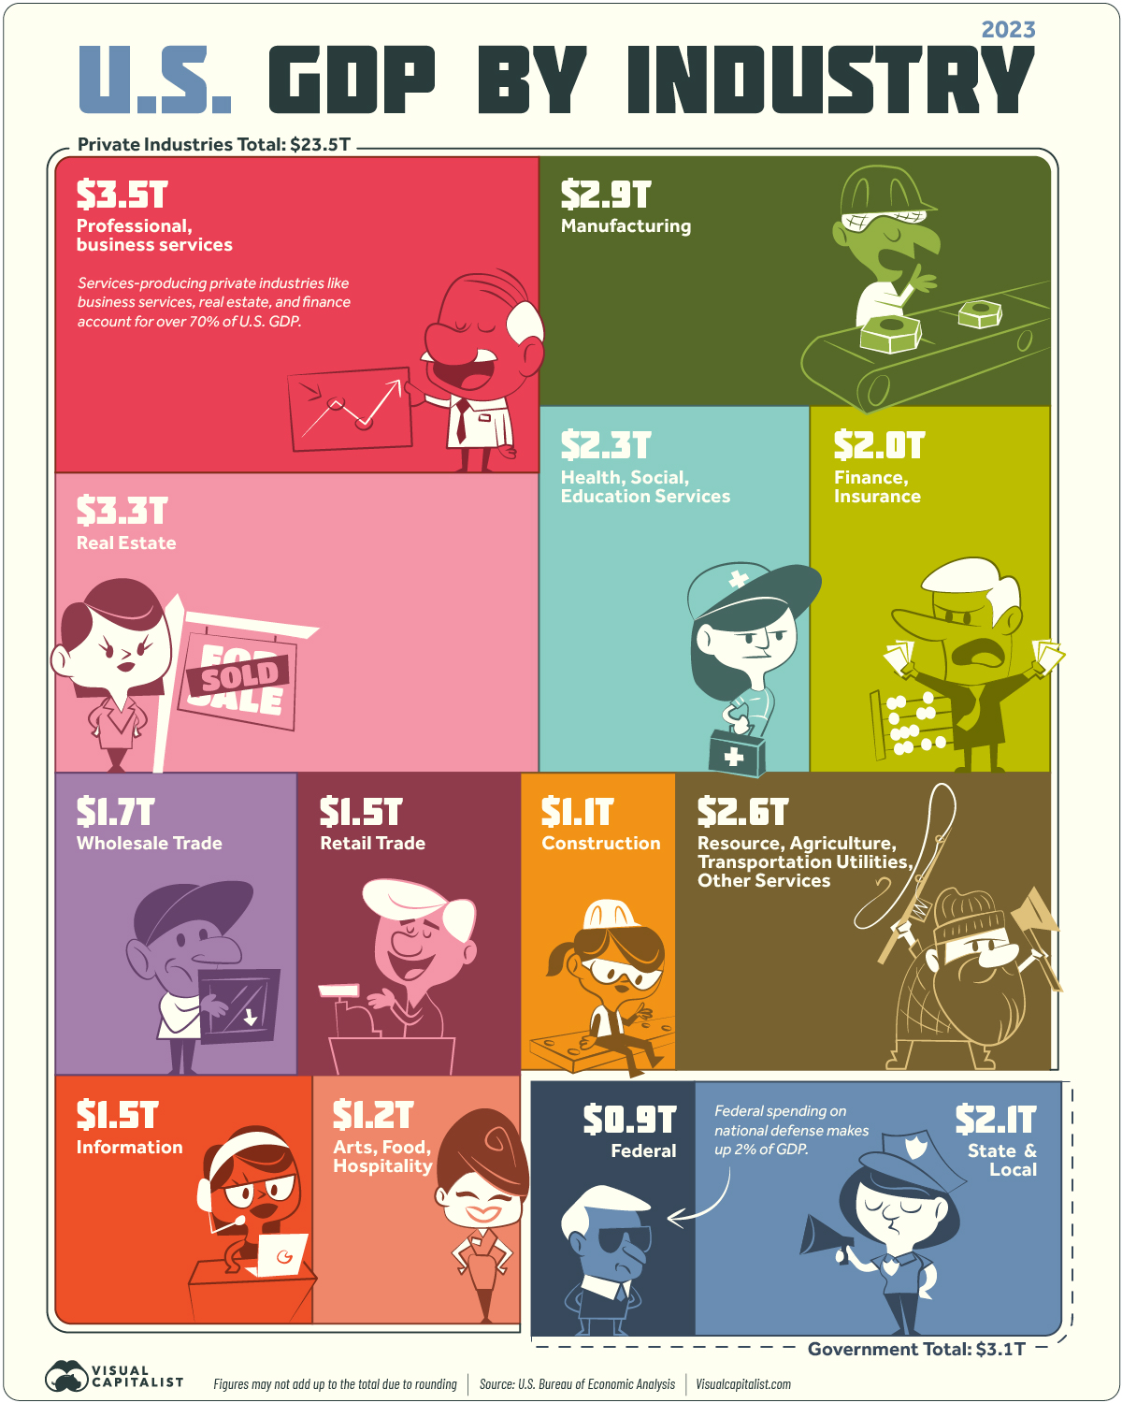

Slide 21
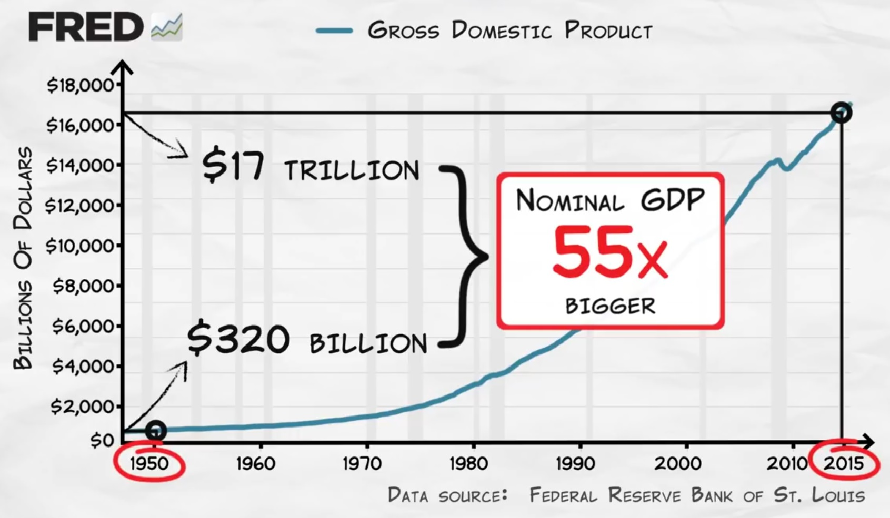
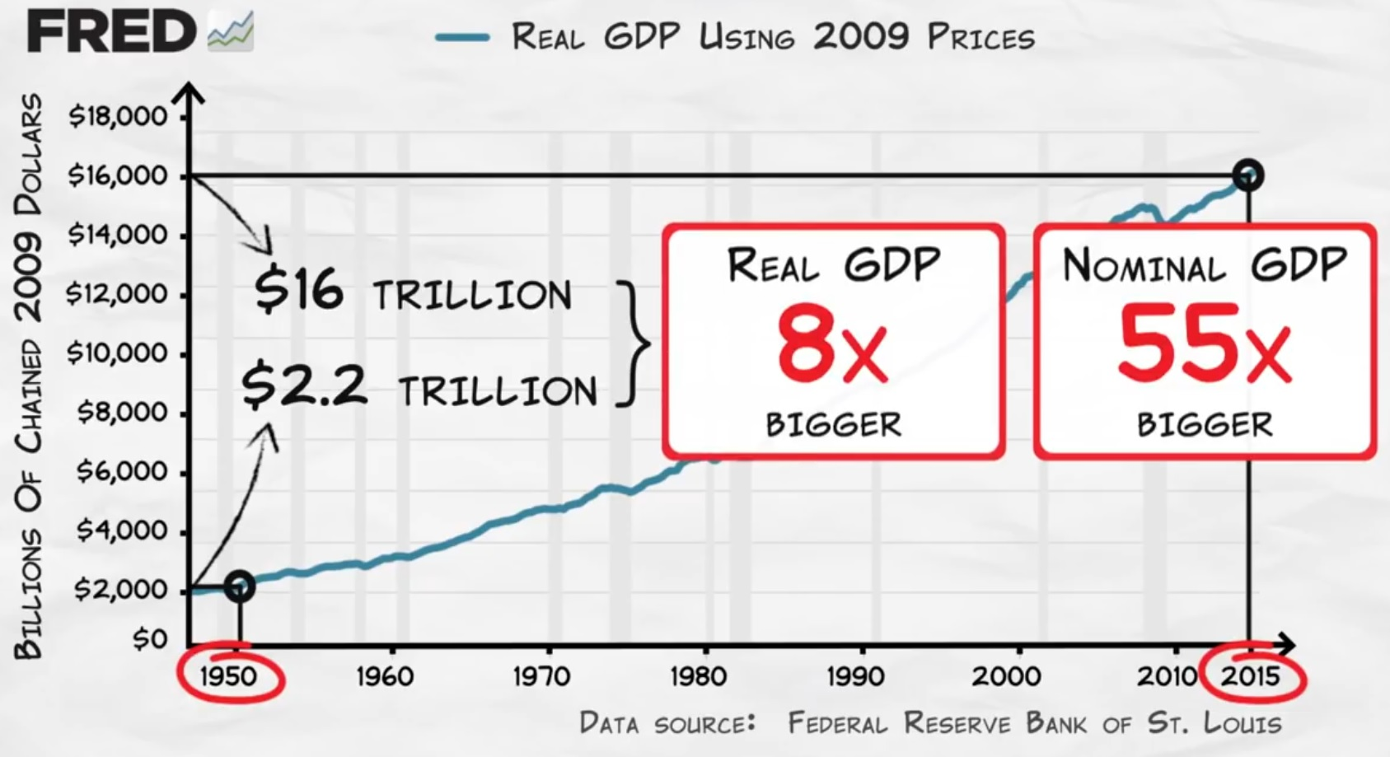
Calculating Real GDP
Consider these 2 graphs.
Nominal GDP: can ∆ when P ∆, Q ∆ or both ∆
Real GDP: can only ∆ when Q ∆

Slide 22

Nominal v Real GDP
Nominal GDP: value of goods & services produced at current prices
Real GDP: value of goods & services produced at constant prices
Adjusted for inflation

Slide 23
Nominal v Real GDP Calculations
Year | Price of a Cup of Coffee | Quantity (Cups) of Coffee | Price of Cupcakes | Quantity of Cupcakes
2020 | $2.00 | 400 | $1.00 | 200
2021 | $3.00 | 600 | $1.50 | 300
2022 | $4.00 | 800 | $2.00 | 400
Nominal GDP Calculation:
2020: $2.00 * 400 cups of coffee + $1.00 * 200 cupcakes = $1,000 2021: $3.00 * 600 cups of coffee + $1.50 * 300 cupcakes = $2,250 2022: $4.00 * 800 cups of coffee + $2.00 * 400 cupcakes = $4,000
Real GDP Calculation:
2020: $2.00 * 400 cups of coffee + $1.00 * 200 cupcakes = $1,000 2021: $2.00 * 600 cups of coffee + $1.00 * 300 cupcakes = $1,500 2022: $2.00 * 800 cups of coffee + $1.00 * 400 cupcakes = $2,000

Slide 24
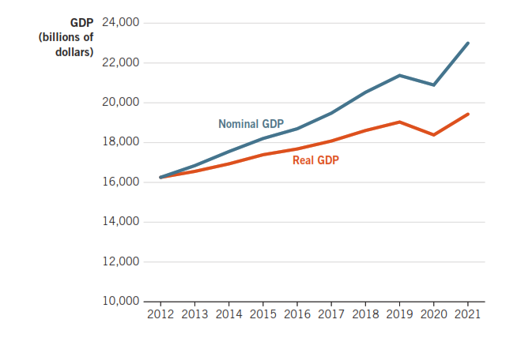
U.S. Nominal & Real GDP (Real GDP is in 2012 dollars)
Inflation

Slide 25
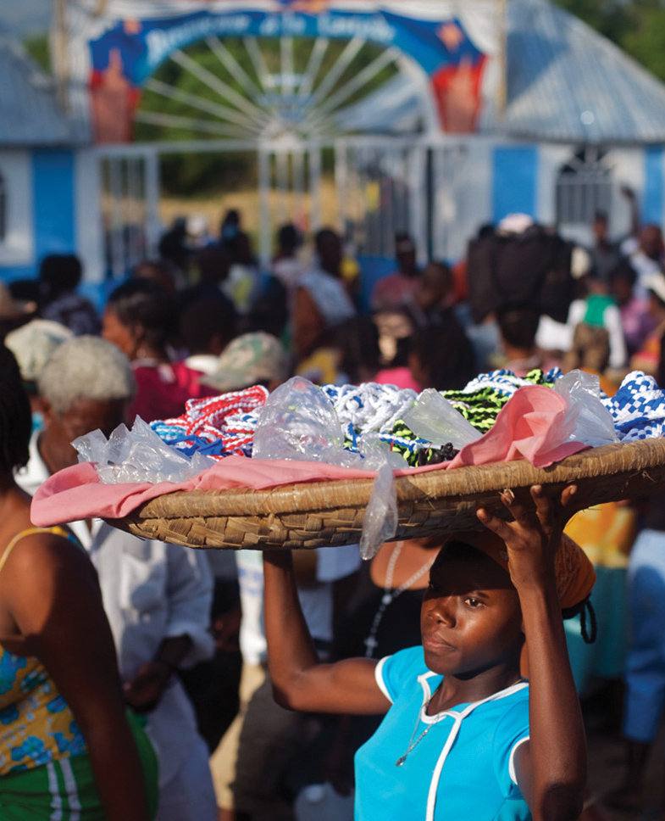
Three Uses of GDP Data
What are the three uses of GDP?
1. Measuring economic growth.
2. Measuring living standards.
3. Determining whether an economy is experiencing recession or expansion.

Slide 26
1. Measuring Economic Growth
GDP data can also be used to measure economic growth over time or changes in average living standards.
Economic growth: the percentage change in real per capita GDP.
Have to adjust GDP for inflation

Slide 27
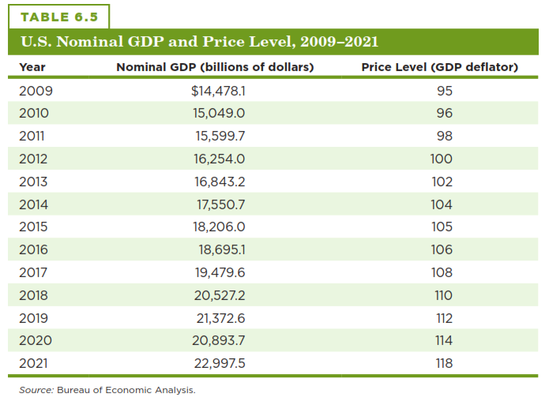

Computing Real GDP
Two steps:
1. Divide to filter out current prices.
2. Multiply to input base-period prices.
Compute 2021 real GDP in 2012 dollars.
$$Real GDP=\frac{Nominal GDP }{Price Level}× 100$$

Slide 28

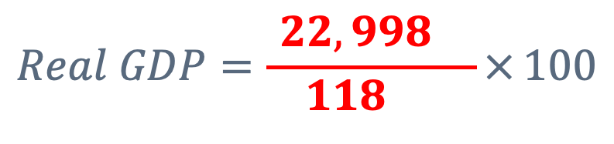
Computing Real GDP
2021 real GDP in 2012 prices is $ 19,490 billion.
$$Real GDP=\frac{Nominal GDP }{Price Level}× 100$$
$$Real GDP=\frac{ 22,998 }{ 118 }× 100$$

Slide 29
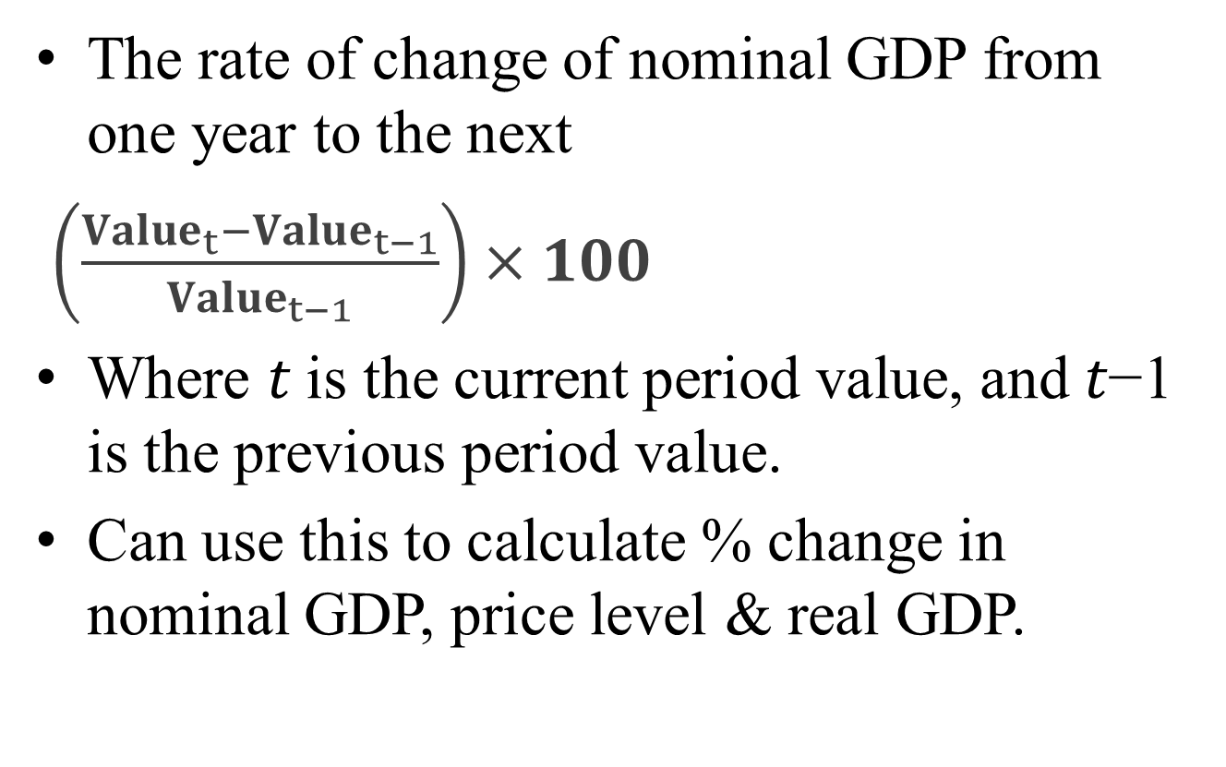
Growth Rates
The rate of change of nominal GDP from one year to the next
$\left(\frac{{Value}_{t}−{Value}_{t−1}}{{Value}_{t−1}}\right)×100$
Where 𝑡 is the current period value, and 𝑡−1 is the previous period value.
Can use this to calculate % change in nominal GDP, price level & real GDP.

Slide 30
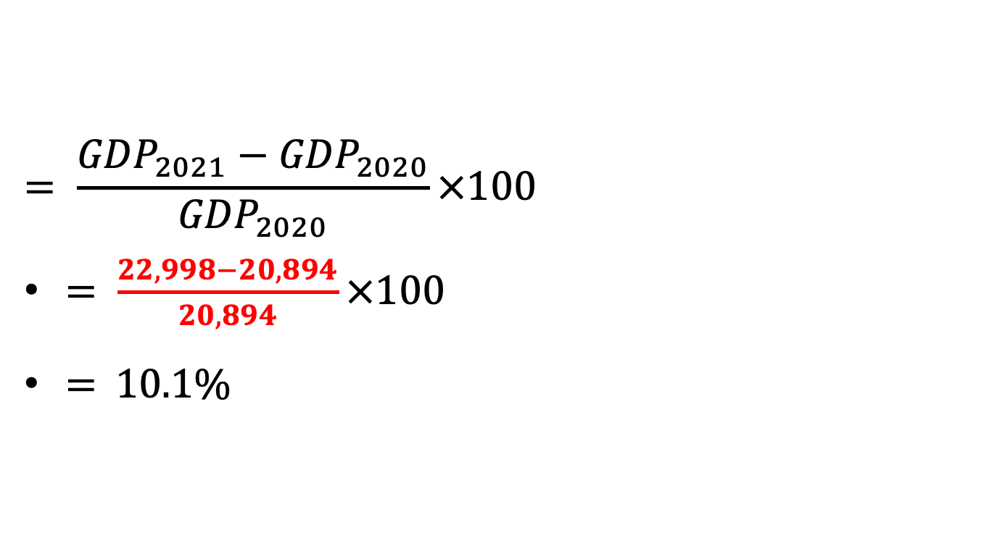
Nominal GDP Growth Rate (2021)
Year | Nominal GDP (billions) | Price Level (GDP deflator)
2020 | 20,894 | 114
2021 | 22,998 | 118
$$= \frac{{GDP}_{2021}−{GDP}_{2020}}{{GDP}_{2020}}×100$$
$= \frac{22,998−20,894}{20,894}×100$
= 10.1%

Slide 31
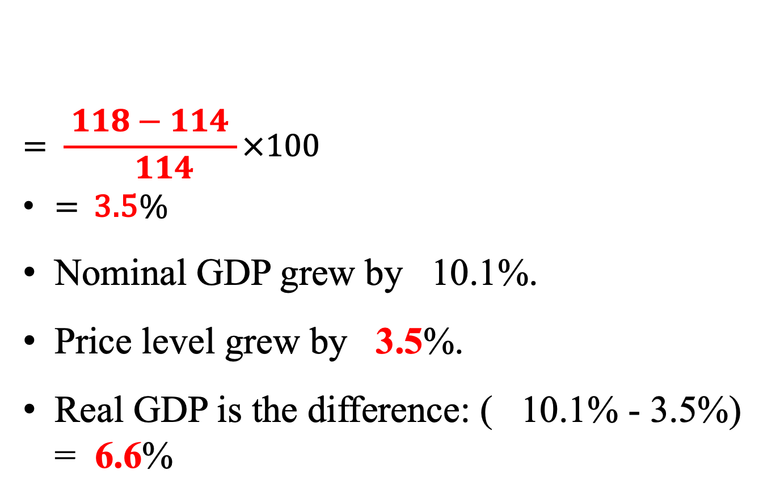
Growth Rate of the Price Level (GDP Deflator) for (2021)
Year | Nominal GDP (billions) | Price Level (GDP deflator)
2020 | 20,894 | 114
2021 | 22,998 | 118
$$= \frac{ 118−114 }{ 114}×100$$
= 3.5%
Nominal GDP grew by 10.1%.
Price level grew by 3.5%.
Real GDP is the difference: ( 10.1% - 3.5%) = 6.6%

Slide 32
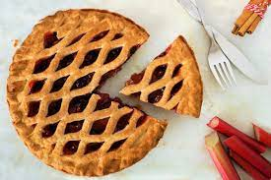
2. Measuring Living Standards
GDP offers us a way of estimating living standards across both time and place.
Does not take into account the population size of a country.
Have to adjust for population differences.
What is more desirable, a bigger GDP or a bigger GDP per capita?

Slide 33
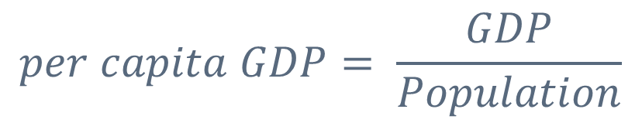
Measuring Living Standards
Per Capita GDP: GDP per person.
Measure of average living standards in a nation.
$$per capita GDP= \frac{GDP}{Population}$$
Country | 2021 GDP (billions of $) | 2021 GDP per capita ($)
China | 16,640 | 11,700
Germany | 4,320 | 52,000

Slide 34
Richest Countries in the World 2023
Interactive chart showing how GDP per capita has changed around the world between 2010-2022.
Top 10 countries by GDP per capita, by Region.

Slide 35
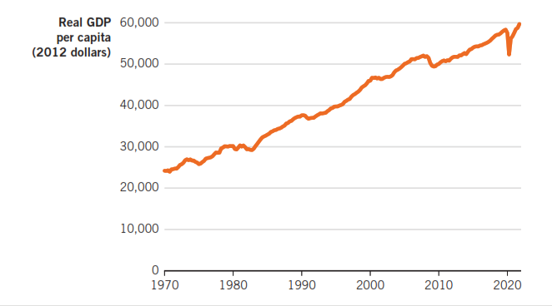
U.S. Real Per Capita GDP, 1970-2021
Emphasize rising living standards over time. FRED.

Slide 36
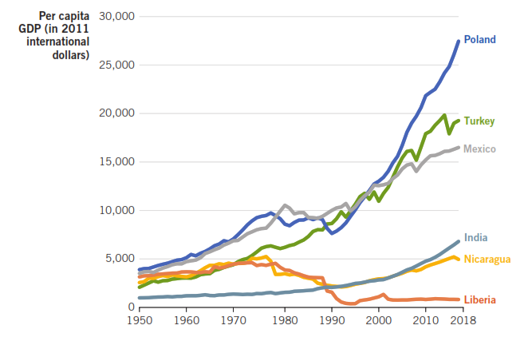
Comparing Economic Growth across nations

Slide 37
3. Business Cycles

Slide 38
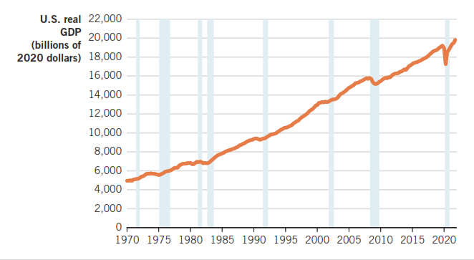
The Business Cycle in the United States

Slide 39

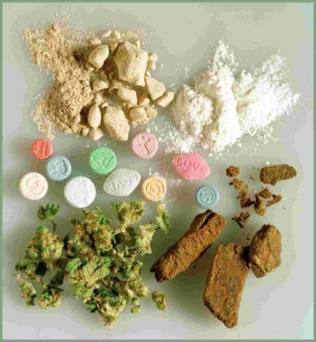
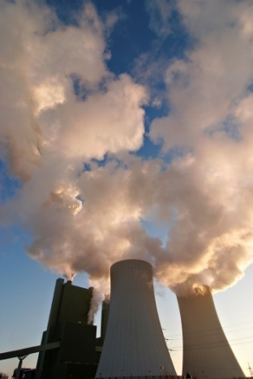


GDP Does Not Fully Account For:
Nonmarket goods
Underground economy
Quality of life
Leisure time
Distribution of income

Slide 40
Shortcomings of GDP
Underground economy
Size of underground economy?
percent of GDP (estimated) in United States
percent in developing countries
Underground economy
Legal
Waitress tips
Babysitting
Illegal
Narcotics exchanges
Prostitution

Slide 41
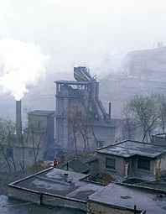
GDP and the Environment
When a factory sells goods, we count the goods in GDP.
When the factory hires a company to clean up the pollution it creates, we also count that in GDP.
GDP the true value created.

Slide 42
Alternatives to GDP Are You Happy on a Scale of 0-10?
“We hold these Truths to be self-evident, that all Men are created equal, that they are endowed by their Creator with certain unalienable Rights, that among these are Life, Liberty and the Pursuit of Happiness. That to secure these Rights, Governments are instituted among Men, deriving their just Powers from the Consent of the Governed, that whenever any Form of Government becomes destructive to these Ends, it is the Right of the People to alter or to abolish it, and to institute new Government, laying its foundation on such Principles and organizing its Powers in such Form, as to them shall seem most likely to effect their Safety and Happiness...”
– Declaration of Independence, 1776.

Slide 43
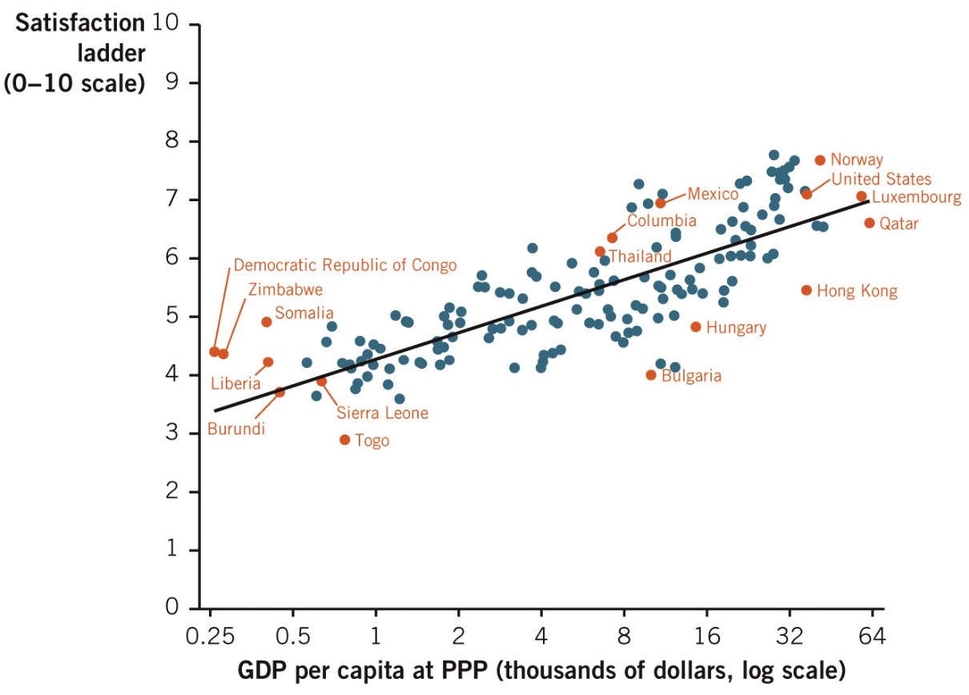
GDP = Happiness?
Life satisfaction is higher in nations with higher incomes.
Conclusion: Higher income presents more opportunities to pursue happiness.

Slide 44
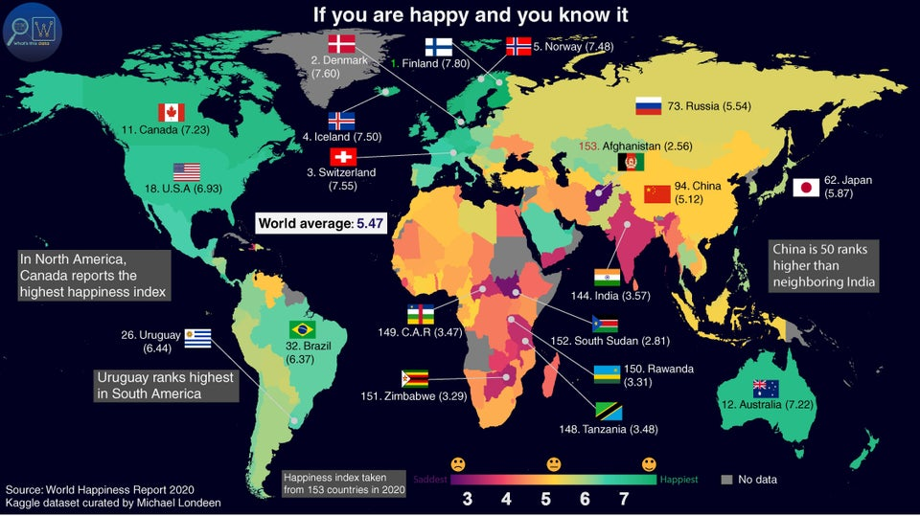
World Happiness Index

